Slide 1

Convert function:
Converts a value into the specified datatype or character set.
Syntax:
Parameter | Description | Description
value | Required. The value to convert | Required. The value to convert
type | Required. The datatype to convert to. Can be one of the following: | Required. The datatype to convert to. Can be one of the following:
 | Value | Description
 | DATE | Converts value to DATE. Format: "YYYY-MM-DD"
 | DATETIME | Converts value to DATETIME. Format: "YYYY-MM-DD HH:MM:SS"
 | DECIMAL | Converts value to DECIMAL. Use the optional M and D parameters to specify the maximum number of digits (M) and the number of digits following the decimal point (D).
 | TIME | Converts value to TIME. Format: "HH:MM:SS"
 | CHAR | Converts value to CHAR (a fixed length string)
 | NCHAR | Converts value to NCHAR (like CHAR, but produces a string with the national character set)
 | SIGNED | Converts value to SIGNED (a signed 64-bit integer)
 | UNSIGNED | Converts value to UNSIGNED (an unsigned 64-bit integer)
 | BINARY | Converts value to BINARY (a binary string)
charset | Required. The character set to convert to | Required. The character set to convert to

Slide 2
Date time function:
ADDDATE(): add a period of times to date.
Syntax: has two types
ADDDATE (date, Interval Value add_unit)
Ex: SELECT ADDDATE ('2019-01-02', INTERVAL 31 DAY);
=> results = 2019 – 02 – 02
ADDDATE (date, days)
Ex: SELECT ADDDATE ('2019-01-02', 31);
=> results = 2019 – 02 – 02
DATEDIFF(): returns the number of days between two date values.
Syntax:
DATEDIFF (date1, date2);
DAY(), MONTH(), YEAR()
Syntax:
DAY(date);
MONTH(date);
YEAR(date);
Ex: SELECT DAY("2017-06-15 09:34:21");
Ex: SELECT MONTH("2017-06-15 09:34:21");
Ex: SELECT YEAR("2017-06-15 09:34:21");

Slide 3
String function:
RTRIM(), LTRIM(): Loại bỏ khoảng trắng khỏi một chuỗi từ phía trái hoặc phải
Syntax:
RTRIM (string);
LTRIM (string);
SUBSTRING(): extracts a substring from a string (starting at any position).
SUBSTRING (string, start, length);
LENGTH(): returns the length of a string (in bytes)
LENGTH (string);
CHAR_LENGTH() / CHARACTER_LENGTH() : return the length of a string (in characters).
CHAR_LENGTH (string);
POSITION(): returns the position of the first occurrence of a substring in a string. If the substring is not found within the original string, this function returns 0.
POSITION (substring IN string);

Slide 4
Aggregate function:
Used to perform calculations on multiple values and return the result in a single value like the average of all values, the sum of all values, and maximum & minimum value among certain groups of values.
Mostly use the aggregate functions with SELECT statements in the data query languages.
Aggregate Function | Descriptions
count() | Returns the number of rows, including rows with NULL values in a group.
sum() | Returns the total summed values (Non-NULL) in a set.
average() | Returns the average value of an expression.
min() | Returns the minimum (lowest) value in a set.
max() | Returns the maximum (highest) value in a set.
groutp_concat() | Returns a concatenated string.
first() | Returns the first value of an expression.
last() | Returns the last value of an expression.

Slide 5
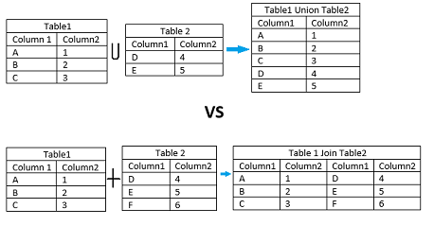
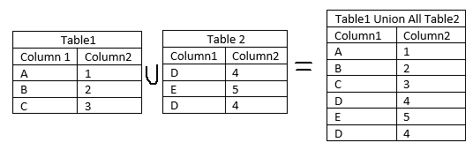
Union & Union all:
Used in the database for combining the result set from multiple tables.
These operators allow us to use multiple SELECT queries, retrieve the desired results, and then combine them into a final output.
Union:
Remove the duplicate rows from the tables
Union basic rule:
The number and order of the columns should be the same in all queries.
The corresponding columns position of each select query must have a compatible data type.
The column name selected in the different SELECT queries must be in the same order.
The column name of the first SELECT query will be the column names of the output.
Union and Join are different things:
JOIN combines data from multiple different tables, whereas UNION combines data from multiple similar tables.
JOIN appends the output horizontally, whereas UNION combines the result set vertically.
Syntax:
SELECT column_list FROM table1
UNION
SELECT column_list FROM table2;
Union all:
Does not remove the duplicate rows from the output of the SELECT statements.
Syntax:
SELECT column_list FROM table1 UNION ALL SELECT column_list FROM table2;

Slide 6

Select … into … from …:
Chọn dữ liệu nào đó vào bảng mới từ bảng cũ
Syntax:
SELECT *
INTO bảng_mới [IN database_khác]
FROM bảng_cũ
WHERE điều_kiện;
- Rất tiếc là chỉ dùng được cho SQL server
Insert into … select … from …:
Insert into bảng mới select dữ liệu nào đó from bảng cũ where điều kiện gì đó.
Điều kiện :
+ yêu cầu các kiểu dữ liệu trong các bảng nguồn và đích phù hợp.
+ các bản ghi hiện có trong bảng đích không bị ảnh hưởng.
Syntax:
INSERT INTO bảng_2
SELECT * FROM bảng_1
WHERE điều_kiện;
Cast():
The CAST() function converts a value (of any type) into the specified datatype.
Syntax:
Example:
SELECT CAST(150 AS CHAR);
SELECT CAST("14:06:10" AS TIME);
SELECT CAST(5-10 AS SIGNED);

